Slide 2
Resources from the Public Health Foundation
Evidence-based Resources for Improving Community Health ACHI/PHF webinar on use of evidence–based community interventions by hospitals www.train.org – Course ID #: 1047702 Stories and webinars on uses of the Guide to Community Preventive Services www.phf.org/communityguide
TRAIN – the nation’s premier learning management network for professionals helping to protect the public’s health – over 750,000 registered learners and 29,000 courses www.train.org
Learning Resource Center – where public health, health care, and allied health professionals find high quality training materials at an affordable price Comprehensive selection of public health quality improvement publications Many consumer-oriented health education publications bookstore.phf.org
Quality Improvement Quality improvement tools and resources to help improve individual and organizational performance www.phf.org/qualityimprovement Public health driver diagram, used to help align efforts of health care and public health www.phf.org/programs/antibioticstewardship

Slide 3
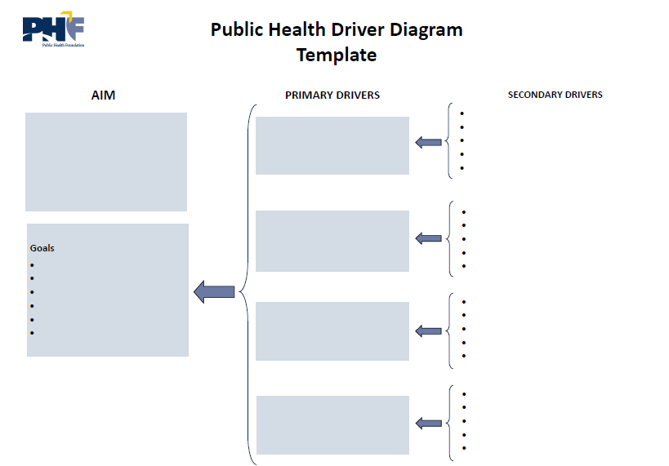
Reduced Hospital
Readmissions
Visit www.phf.org to learn more about the Public Health Foundation’s quality improvement, performance management, and workforce development initiatives

Slide 4
Reduced Hospital
Readmissions
Visit www.phf.org to learn more about the Public Health Foundation’s quality improvement, performance management, and workforce development initiatives

