Slide 1
The Public Health Performance Management System Framework
Introduction & Application to Public Health

Slide 2
These slides were developed through a cooperative agreement with the Centers for Disease Control and Prevention’s (CDC’s) Office of State, Tribal, Local, and Territorial Support (OSTLTS), through the National Public Health Improvement Initiative (NPHII) with funding from the Affordable Care Act Capacity Building Assistance to Improve Public Health Infrastructure Investments. Disclaimer: The guidance provided in this tool is that of the authors and does not necessarily represent the official position of or endorsement by the Centers for Disease Control and Prevention.

Slide 3
What is Performance Management?
“Performance management is the practice of actively using performance data to improve the public's health.
This practice involves the strategic use of performance measures and standards to establish performance targets and goals.”
Source: From Silos to Systems: Using Performance Management to Improve Public Health Systems – prepared by the Public Health Foundation for the Performance Management National Excellence Collaborative, 2003
Notes:
Performance management uses a set of management and analytic processes supported by technology that enables an organization to define strategic goals and then measure and manage performance against those goals.

Slide 4
What is Performance Management?
A systematic process by which an organization involves its employees in improving the effectiveness of the organization and achieving the organization’s mission and strategic goals.
By improving performance and quality, public health systems can save lives, cut costs, and get better results.
Enables health departments to be more:
Efficient
Effective
Transparent
Accountable

Slide 5
What is Performance Management?
Core practices and processes generally include:
goal setting
financial planning
operational planning
data collection
consolidation of data
data analysis
reporting of data
quality improvement
evaluation of results
monitoring of key performance indicators
others???
The focus of these performance management activities is to ensure that goals are consistently met in an effective and efficient manner by an organization, a department, or an employee.

Slide 6
The Importance of Performance Management
Ways that performance management can positively influence a public health agency include:
better return on dollars invested in health
greater accountability for funding and increases in the public’s trust
reduced duplication of efforts
better understanding of public health accomplishments and priorities among employees, partners, and the public
increased sense of cooperation and teamwork
increased emphasis on quality, rather than quantity
improved problem-solving

Slide 7
Performance Management Federal Government Perspective
The Accountable Government Initiative - an Update on Our Performance Management Agenda states that performance management efforts for 2011 are focused on six strategies that have the highest potential for achieving meaningful performance improvement within and across Federal agencies:
1. Driving agency top priorities
2. Cutting waste
3. Reforming contracting
4. Closing the Information Technology gap
5. Promoting accountability and innovation through open government
6. Attracting and motivating top talent
Source: Memorandum for the senior executive service; Jeffrey D. Zients, Federal Chief Performance Officer and Deputy Director for Management, Office of Management and Budget; 9/14/2010

Slide 8
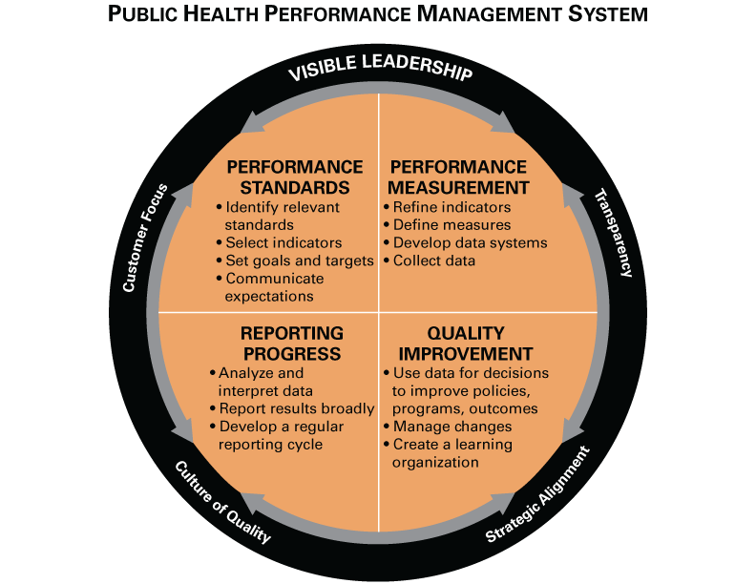
Developed in 2013, adapted from the 2003 Turning Point
Performance Management System Framework
Notes:
Most have seen this Turning Point Model – the 30,000 foot view of what we’re talking about today.
Turning Point Performance Management National Excellence Collaborative convened about a decade ago. Four year collaborative funded by RWJF established in 2000.
Turning Point Performance Management Collaborative (PMC) – seven states (AK, IL, MO, MT, NH, NY, WV) and five national partners (ASTHO, NACCHO, CDC, HRSA, PHF) working to study and promote systems to manage public health performance
20+ years ago where we started seeing literature and observation about performance management working in other industries. We began asking questions, what does performance management look like in public health?
Managing performance is what you do at the program, organization (local/state), or system level to ensure you get results. It’s the opposite of leaving things to chance.

Slide 9
Performance Standards
Standards may be set based on national, state or scientific organizations, by benchmarking against similar organizations, or by other methods.
Example in practice: Healthy People 2020 objective of a 10% improvement in the cases of pertussis among children under 1 year of age(National Notifiable Diseases Surveillance System) and reduce severe allergic reactions to food among adults with a food allergy diagnosis to 21% from 29.3% (Food Safety Survey)
Source: www.HealthlyPeople.gov

Slide 10
Performance Standards
Identify relevant standards
Select indicators
Set goals and targets
Communicate expectations
Think about:
Do you set or use standards, targets or goals for your organization or program?
How do you communicate the expectations and strategic direction for your organization or program?

Slide 11
Performance Measurement
It is important to set criteria and establish scope (programmatic vs. state)
Example in practice: New Hampshire used the following criteria to select final measures:
Data should be available for several years to show trends.
Data should be reliable, in that we are confident in the accuracy of the data and that it measures what is intended to measure.
The measures should reflect new and growing initiatives.
The measures should be a good indicator of whether or not a program or intervention is working.
Source: Improving the Public’s Health in New Hampshire, 2005. http://www.dhhs.nh.gov/dphs/iphnh/documents/report.pdf

Slide 12
Performance Measurement
Refine indicators and define measures
Develop data systems
Collect data
Think about:
How do you measure capacity, process or outcomes?
What tools exist to support the efforts?

Slide 13
Reporting Progress
Reporting Progress is how a public health agency tracks and reports progress depending upon the purpose of its performance management system and the intended users of performance data. A robust reporting system makes comparisons to national, state, or local standards or benchmarks to show where gaps may exist within the system.

Slide 14
Reporting of Progress
Analyze and interpret data
Report results broadly
Develop a regular reporting cycle
Think about:
Do you document or report your unit / program’s progress?
Is this information regularly available? To whom?
What is the frequency of analysis and reporting?

Slide 15
Quality Improvement
Quality Improvement (QI) is the establishment of a program or process to manage change and achieve quality improvement in public health policies, programs, or infrastructure based on performance standards, measures, and reports.
Most Commonly Used QI Tools
Brainstorming, Flow Chart, SIPOC+CM, Cause and Effect Diagram, Five Whys, Solution and Effect Diagram, Check Sheets, Pareto Charts, Pie Charts, Run Charts, Control Chart, Force Field Analysis, Nominal Group Technique

Slide 16
Quality Improvement
Use data for decisions to improve policies, programs and outcomes
Manage changes
Create a learning organization
Think about:
Do you have a quality improvement process?
What do you do with information gathered through reports?
Do you have the capacity to take action for improvement when needed?

Slide 17
Visible Leadership
Visible Leadership - Senior management commitment to a culture of quality that aligns performance management practices with the organizational mission, regularly takes into account customer feedback, and enables transparency about performance against targets between leadership and staff.

Slide 18
Visible Leadership
Engage leadership in performance management
Align performance management with organizational priorities
Track and incentivize progress
Think about:
Does senior management take a visible role in performance management?
Is performance management emphasized as a priority and goal for your work?

Slide 19
Leadership and QI Culture
Example in practice: Baldrige Assessment is routinely given to leaders and staff
LEADER VERSION: http://www.nist.gov/baldrige/publications/upload/ProgressAL.pdf
EMPLOYEE VERSION – p.2: http://www.nist.gov/baldrige/publications/upload/Progress.pdf

Slide 20
Performance Management in Public Health Today
QI Definition in Public Health
Journal of Public Health Management Practice (JPHMP) January/February 2010 issue focused exclusively on QI in public health
http://journals.lww.com/jphmp/toc/2010/01000
Public Health Initiatives
National Public Health Performance Standards Program (NPHPSP)
RWJF’s Multi-state Learning Collaborative (MLC)
CDC’s Winnable Battles
National Public Health Improvement Initiative (NPHII)
National Prevention Strategy (June 2011)
Public Health Accreditation Board
QI Practice Exchange
Accreditation Domain 9 required documentation
Notes:
Ten years since TP Framework and materials developed.
Changing environment – QI has been defined and more accepted and more QI tools have been developed, translated from industry.
New initiatives (e.g., NPHII initiative is encouraging health departments to move in direction of QI)
Accreditation: Domain 9 required documentation (PHAB Accreditation Standards and Measures pg. 192-195):
9.1.1 A – Engage staff at all organizational levels in establishing or updating a performance management system
9.1.2 A – Implement a performance management system
“9.1.2.A - The health department must provide a completed performance management self-assessment that reflects the extent to which performance management practices are being used. The health department may develop its own performance management assessment or use existing models, such as The Performance Management Self-Assessment Tool from the Turning Point Performance Management National Excellence Collaborative (http://www.phf.org/resourcestools/Documents/PM_Self_Assess_Tool.pdf). Self-assessment tools are also available through the Baldrige Performance Excellence Program (http://www.nist.gov/baldrige/enter/self.cfm)”

Slide 21
Questions to ask your organization
Who are the stakeholders in Performance Management?
What important things happened over the past 12-18 months and how did the team perform?
What important issues does the team face?
Are there things that the organization/work group/program is doing that it should not be doing or that it could modify?
Are there things that the team is neglecting to do that it should do?
What things could the team do that would help you perform better?

